Slide 1
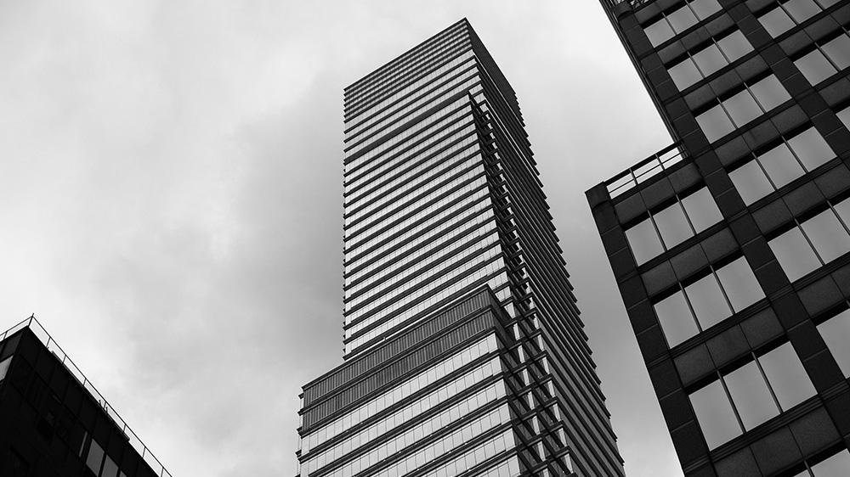
Using Random Forest to Predict Housing Prices
Which variables are most important to predicting the price of housing?
An analysis by Simran Kota and Yusef Haswarey

Slide 2
DATA SOURCE
Dataset
Attributes
Data Cleaning
Features
USA Housing Dataset from Kaggle
81 features, 1460 records
Reduced to 69 features
Mostly categorical
Continuous response variable (sale price)
Notes:
USA Housing Dataset from Kaggle
81 features, 1460 records
Related to house attributes: lot area, neighborhood, overall quality, year built, year remodeled, square footage, rooms, bathrooms, etc.
Narrowed down to 69 features to use in model
Mostly categorical variables, some continuous
Continuous response variable (sale price of house)

Slide 3
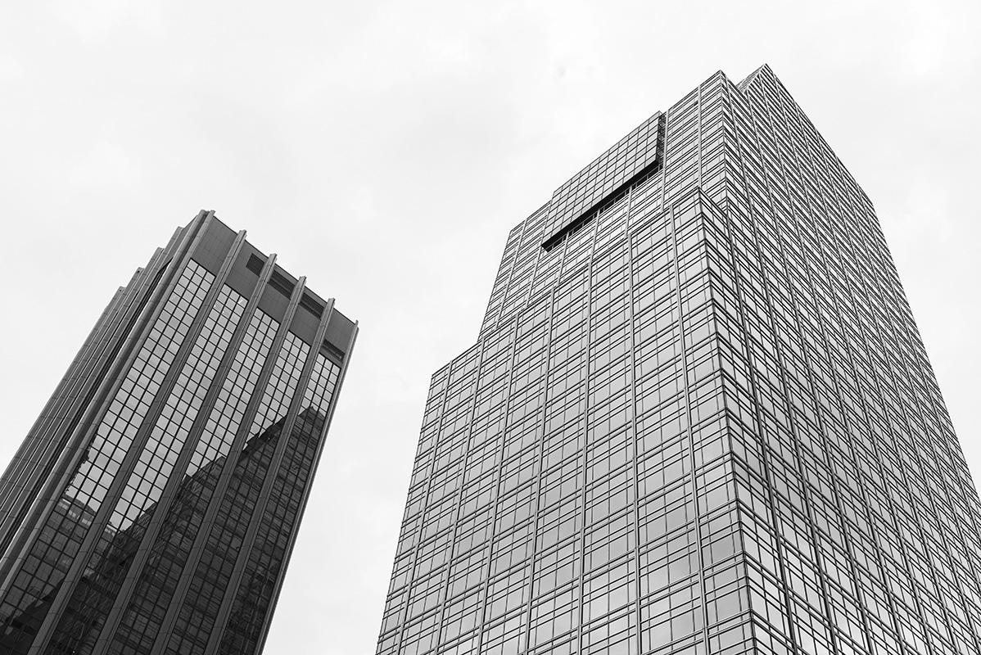
EXPLORATORY DATA ANALYSIS
Lots of null values – houses in dataset might not have certain features
Not all houses have yards, garages, basements, etc.
Replace with a “None” or “Unknown” category for factors, 0 for numeric
Predictors where neither option would work well were excluded
Outcome variable is somewhat normally distributed with outliers – right skewed

Slide 4
RANDOM FOREST
Large collection of uncorrelated decision trees using random subsets of predictor variables and observations
No preprocessing or specific data requirements – can be used for classification or regression, but is slow when used on large datasets
Is a predictive modeling method, not a descriptive modeling method
Basic implementation using randomForest package – we used this package for our analysis
Package features built-in cross-validation – keeps some observations out-of-bag (OOB) for validation purposes

Slide 5
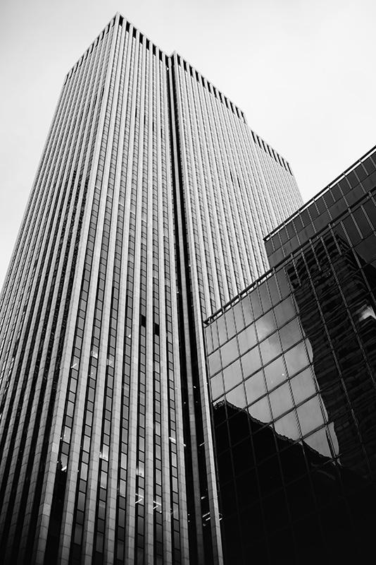
DATA REQUIREMENTS
Dataset
Applications
Performance
Any dataset appropriate for use with a classification or regression method can be used with Random Forest
Random Forest may not be the best method for a given application
Excessively large datasets or time-sensitive applications may require the use of other methods for generating predictions

Slide 6
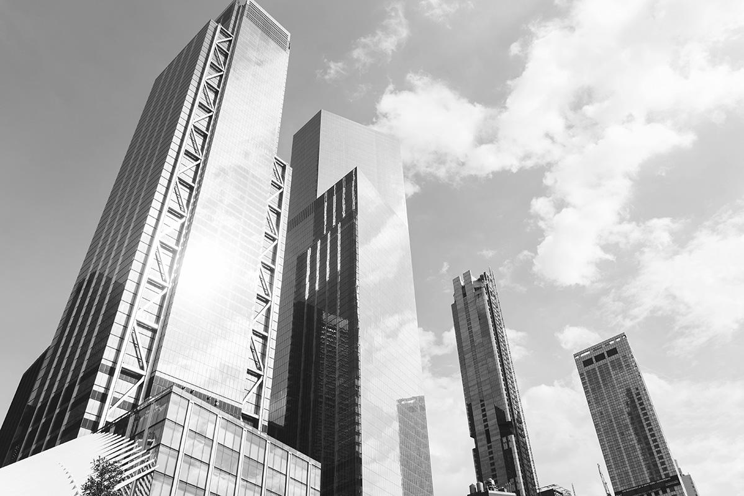
IMPLEMENTATION
Due to its good performance without any tuning, our initial model call included only the formula (SalePrice ~ .) and the full dataset
We also manually split the dataset into a training and validation set to perform our own manual validation of the predictive model
The model function also allows specification of a test dataset – used to perform additional validation alongside OOB set
Randomness in selection of training set and building of decision trees leads to variance in predictions between models

Slide 7
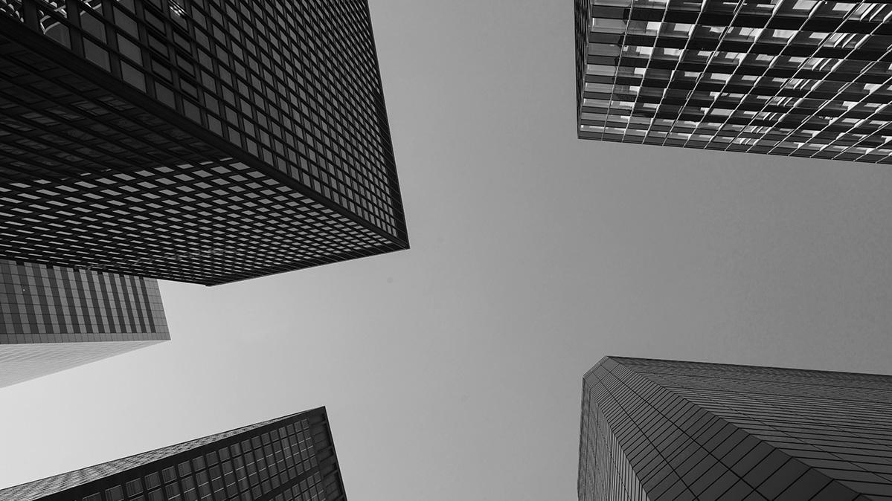
RESULTS
Summary
Predictors
Error Rate
In each model, overall quality was most important predictor variable
Remaining 9 of top 10 predictors saw few changes between models
Root mean square prediction error was around $25k – 30k range for each. This includes the error for both the manual validation and OOB sets.

Slide 8
THANKS
Any questions?
Please keep this slide for attribution

Slide 9

WHOA!
It could be the part of the presentation where you can introduce yourself, write your email...

Slide 10

TABLE OF CONTENTS
1
About Us
2
Products
3
Concept
4
Process
Here you could describe the topic of the section
Here you could describe the topic of the section
Here you could describe the topic of the section
Here you could describe the topic of the section

Slide 11
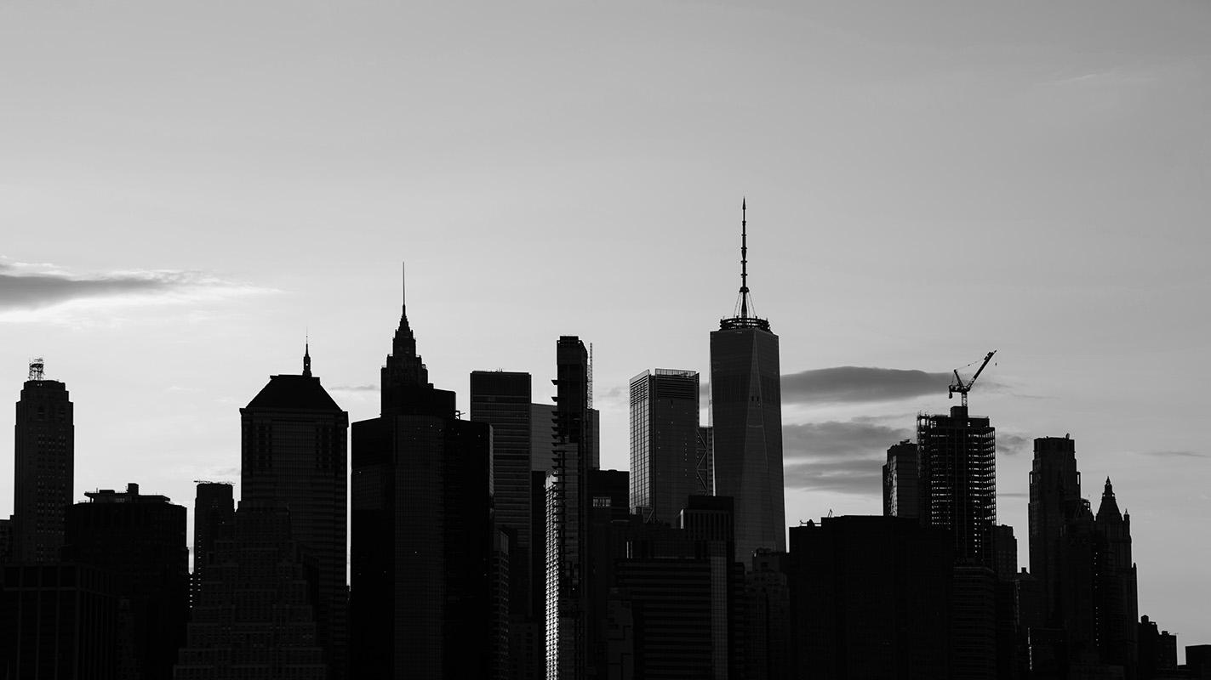
“This is a quote, words full of wisdom that someone important said and can make the reader get inspired.”
—Someone Famous

Slide 12
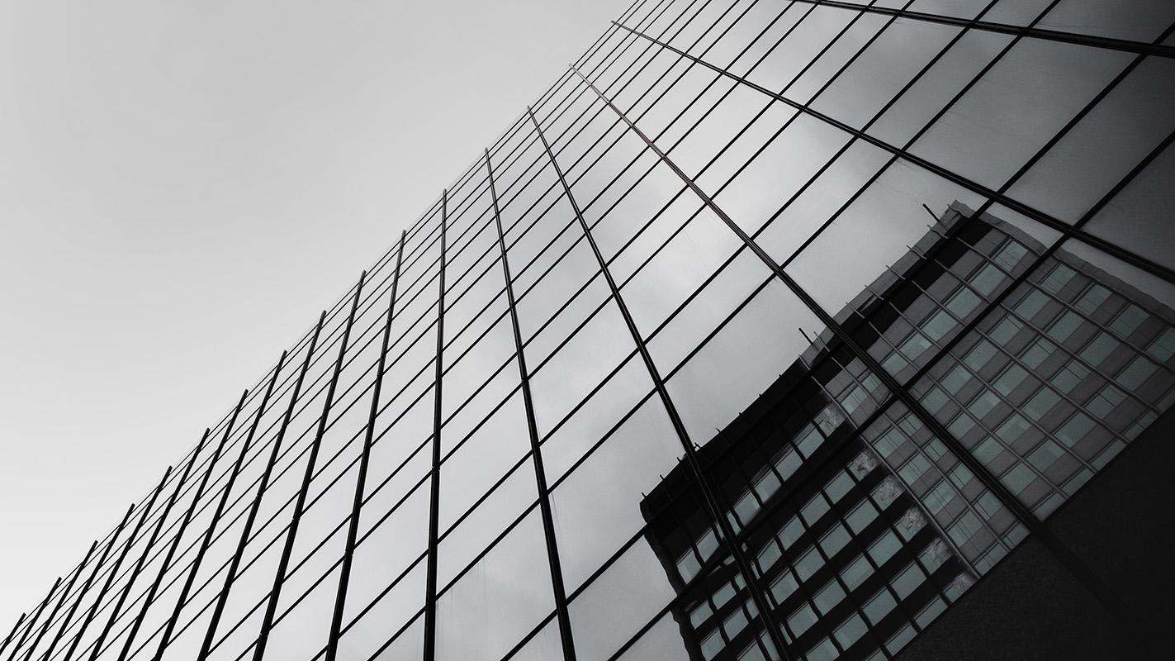
1
ABOUT US
You could enter a subtitle here if you need it

Slide 13

MAYBE YOU NEED TO DIVIDE THE CONTENT
Mercury
Venus
It’s the closest planet to the Sun and the smallest in the Solar System
Venus has a beautiful name and is the second planet from the Sun

Slide 14
LOGO
Despite being red, Mars is a cold place full of iron oxide dust, which is what gives this planet its reddish cast

Slide 15
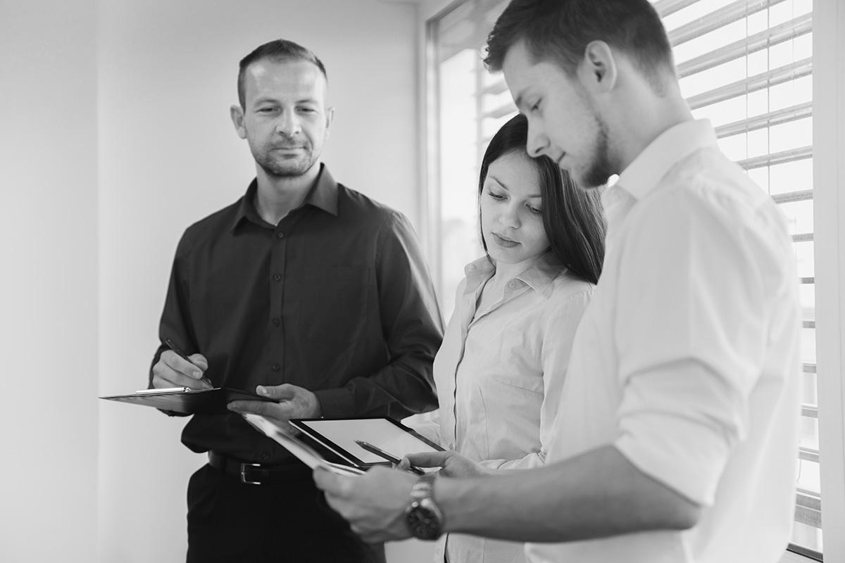
A PICTURE IS WORTH A THOUSAND WORDS
Images reveal large amounts of data, so remember: use an image instead of long texts

Slide 16
SOME OF OUR PREVIOUS CLIENTS
Mars
Saturn
Despite being red, Mars is a cold place full of iron oxide dust
It’s a gas giant, composed mostly of hydrogen and helium

Slide 17

A PICTURE IS WORTH A THOUSAND WORDS

Slide 18

PRACTICAL USES OF THIS SUBJECT
Venus has a beautiful name
Mercury is the smallest planet
Mars is actually a cold place

Slide 19
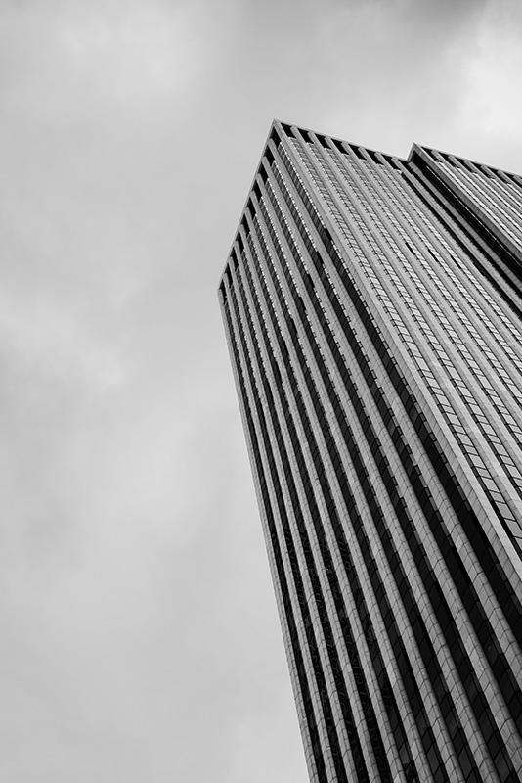
AWESOME WORDS

Slide 20
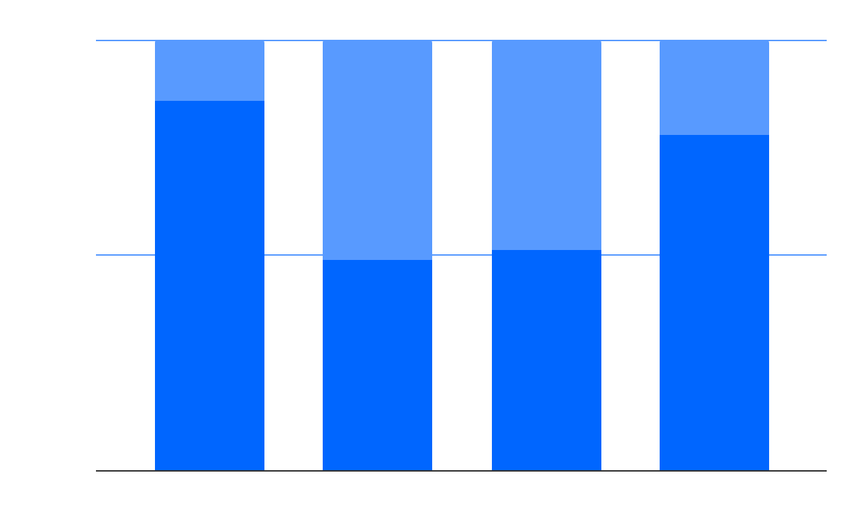
THIS IS A GRAPH
100%
2020
50%
Mars is actually a cold place
0%
2022
Mars
Venus
Mercury
Jupiter
Saturn is the ringed planet
To modify this graph, click on it, follow the link, change the data and paste the new graph here

Slide 21
SOMETIMES, REVIEWING CONCEPTS IS A GOOD IDEA
Venus
Saturn
Mars
Mercury
Jupiter
Earth
It has a beautiful name, but it’s hot
Saturn is the ringed planet
Mars is actually a cold place
Mercury is the smallest planet
Jupiter is the biggest planet
Earth is where we live on

Slide 22
INFOGRAPHICS MAKE YOUR IDEA UNDERSTANDABLE
Mercury
Mars
Mercury was named after a god
Despite being red, Mars is cold
Saturn
Venus
Saturn is the ringed planet
Venus has a beautiful name

Slide 23
A TIMELINE ALWAYS WORKS WELL
Mercury is the smallest planet in the Solar System
2010 - 2014
Despite being red, Mars is actually a cold place
2015 - 2018
Jupiter is the biggest planet in the Solar System
2019 - 2020

Slide 24
OVERVIEW DIAGRAM
Jupiter
It’s the biggest planet in the Solar System
Despite being red, Mars is actually a cold place
Venus is the second planet from the Sun
Saturn is a gas giant and has several rings

Slide 25
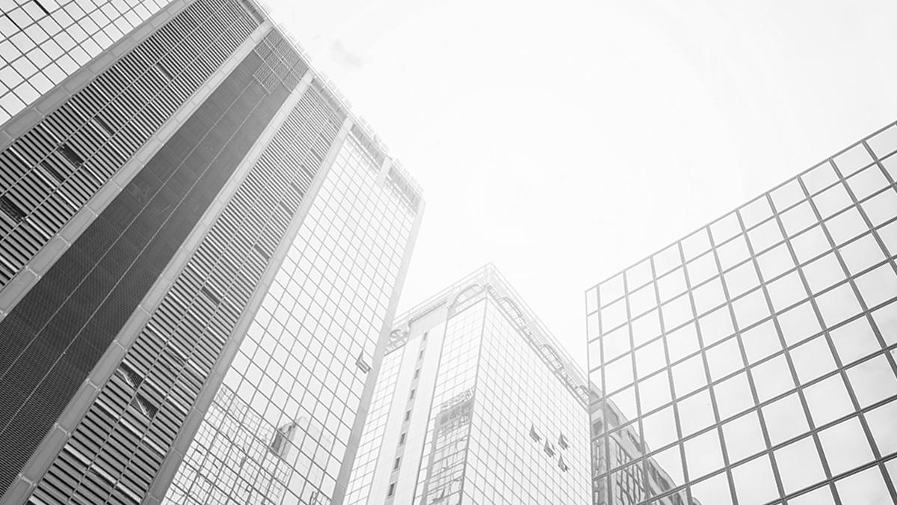
YOU CAN USE A TABLE
 | Mass | Diameter | Gravity
Mars | 0.06 | 0.38 | 0.38
Venus | 0.11 | 0.53 | 0.38
Earth | 95.2 | 9.4 | 1.16

Slide 26
THIS IS A MAP
Saturn
It’s a gas giant and has rings
Mercury
It’s the closest planet to the Sun

Slide 27
$300,000.00
Big numbers catch your audience’s attention

Slide 28
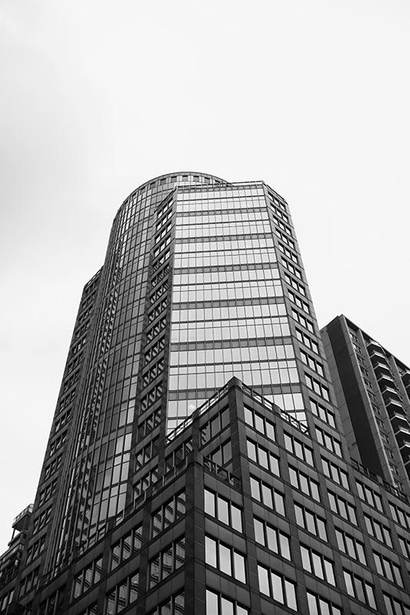
$10,300.00
$20,600.00
$15,400.00
Mercury is the smallest planet in the Solar System
Despite being red, Mars is actually a cold place
Jupiter is the biggest planet in the Solar System

Slide 29
HOW ABOUT THESE PERCENTAGES?
90%
40%
76%
Mercury
Saturn
Mars
It’s the closest planet to the Sun
It’s a gas giant and has rings
Despite being red, Mars is cold

Slide 30
YOU MIGHT PREFER ANOTHER TIMELINE
1
2
3
Venus has a beautiful name
Mars is actually a cold place
Saturn is the ringed planet

Slide 31


OUR TEAM
Jenna Doe
John James
You can replace the image on the screen with your own one
You can replace the image on the screen with your own one

Slide 32
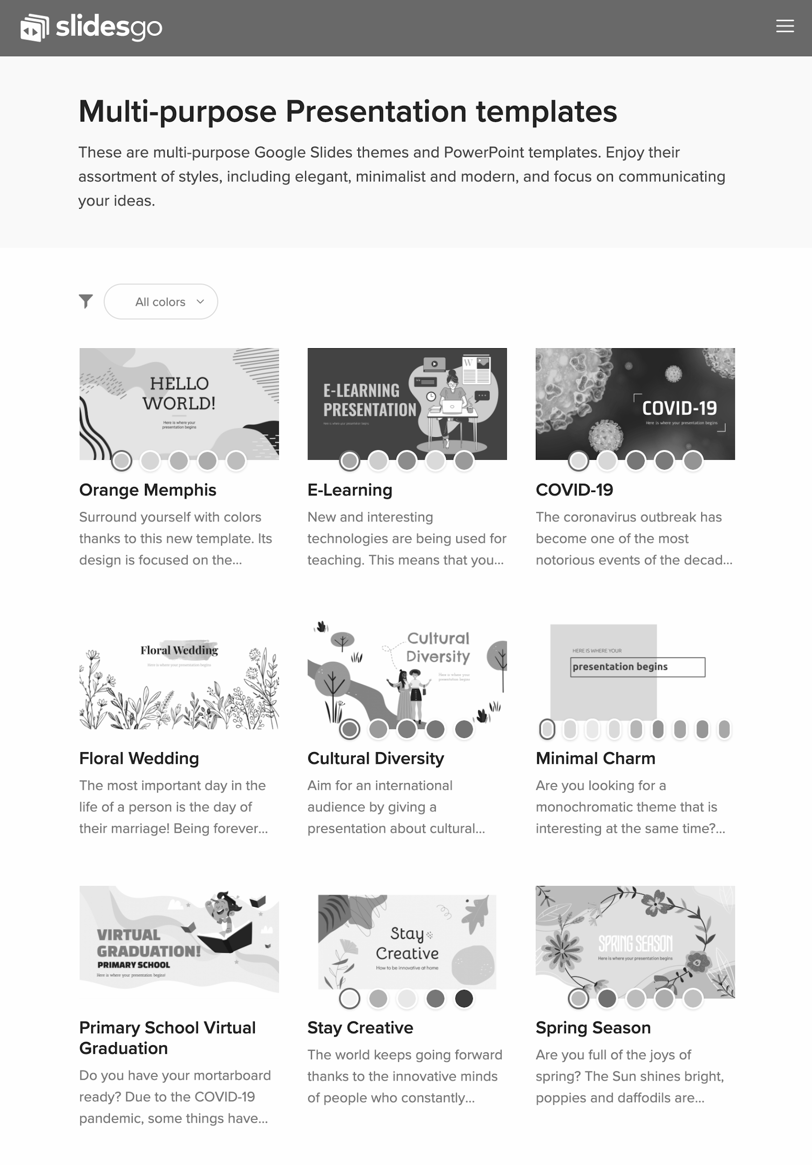
TABLET APP
You can replace the image on the screen with your own work. Just delete this one, add yours and center it properly

Slide 33
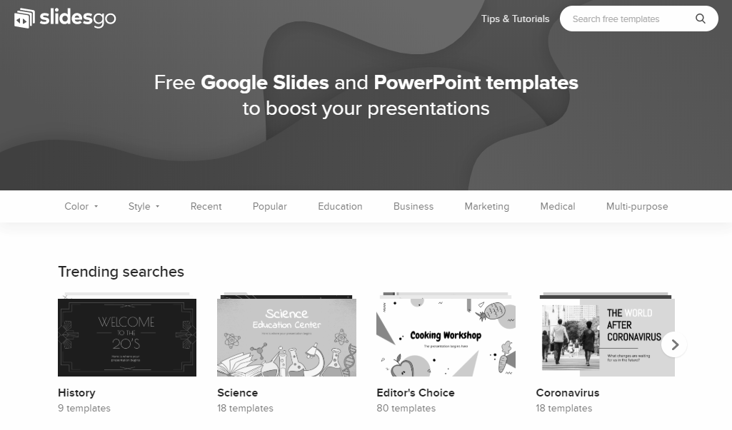
DESKTOP SOFTWARE
You can replace the image on the screen with your own work. Just delete this one, add yours and center it properly

Slide 34
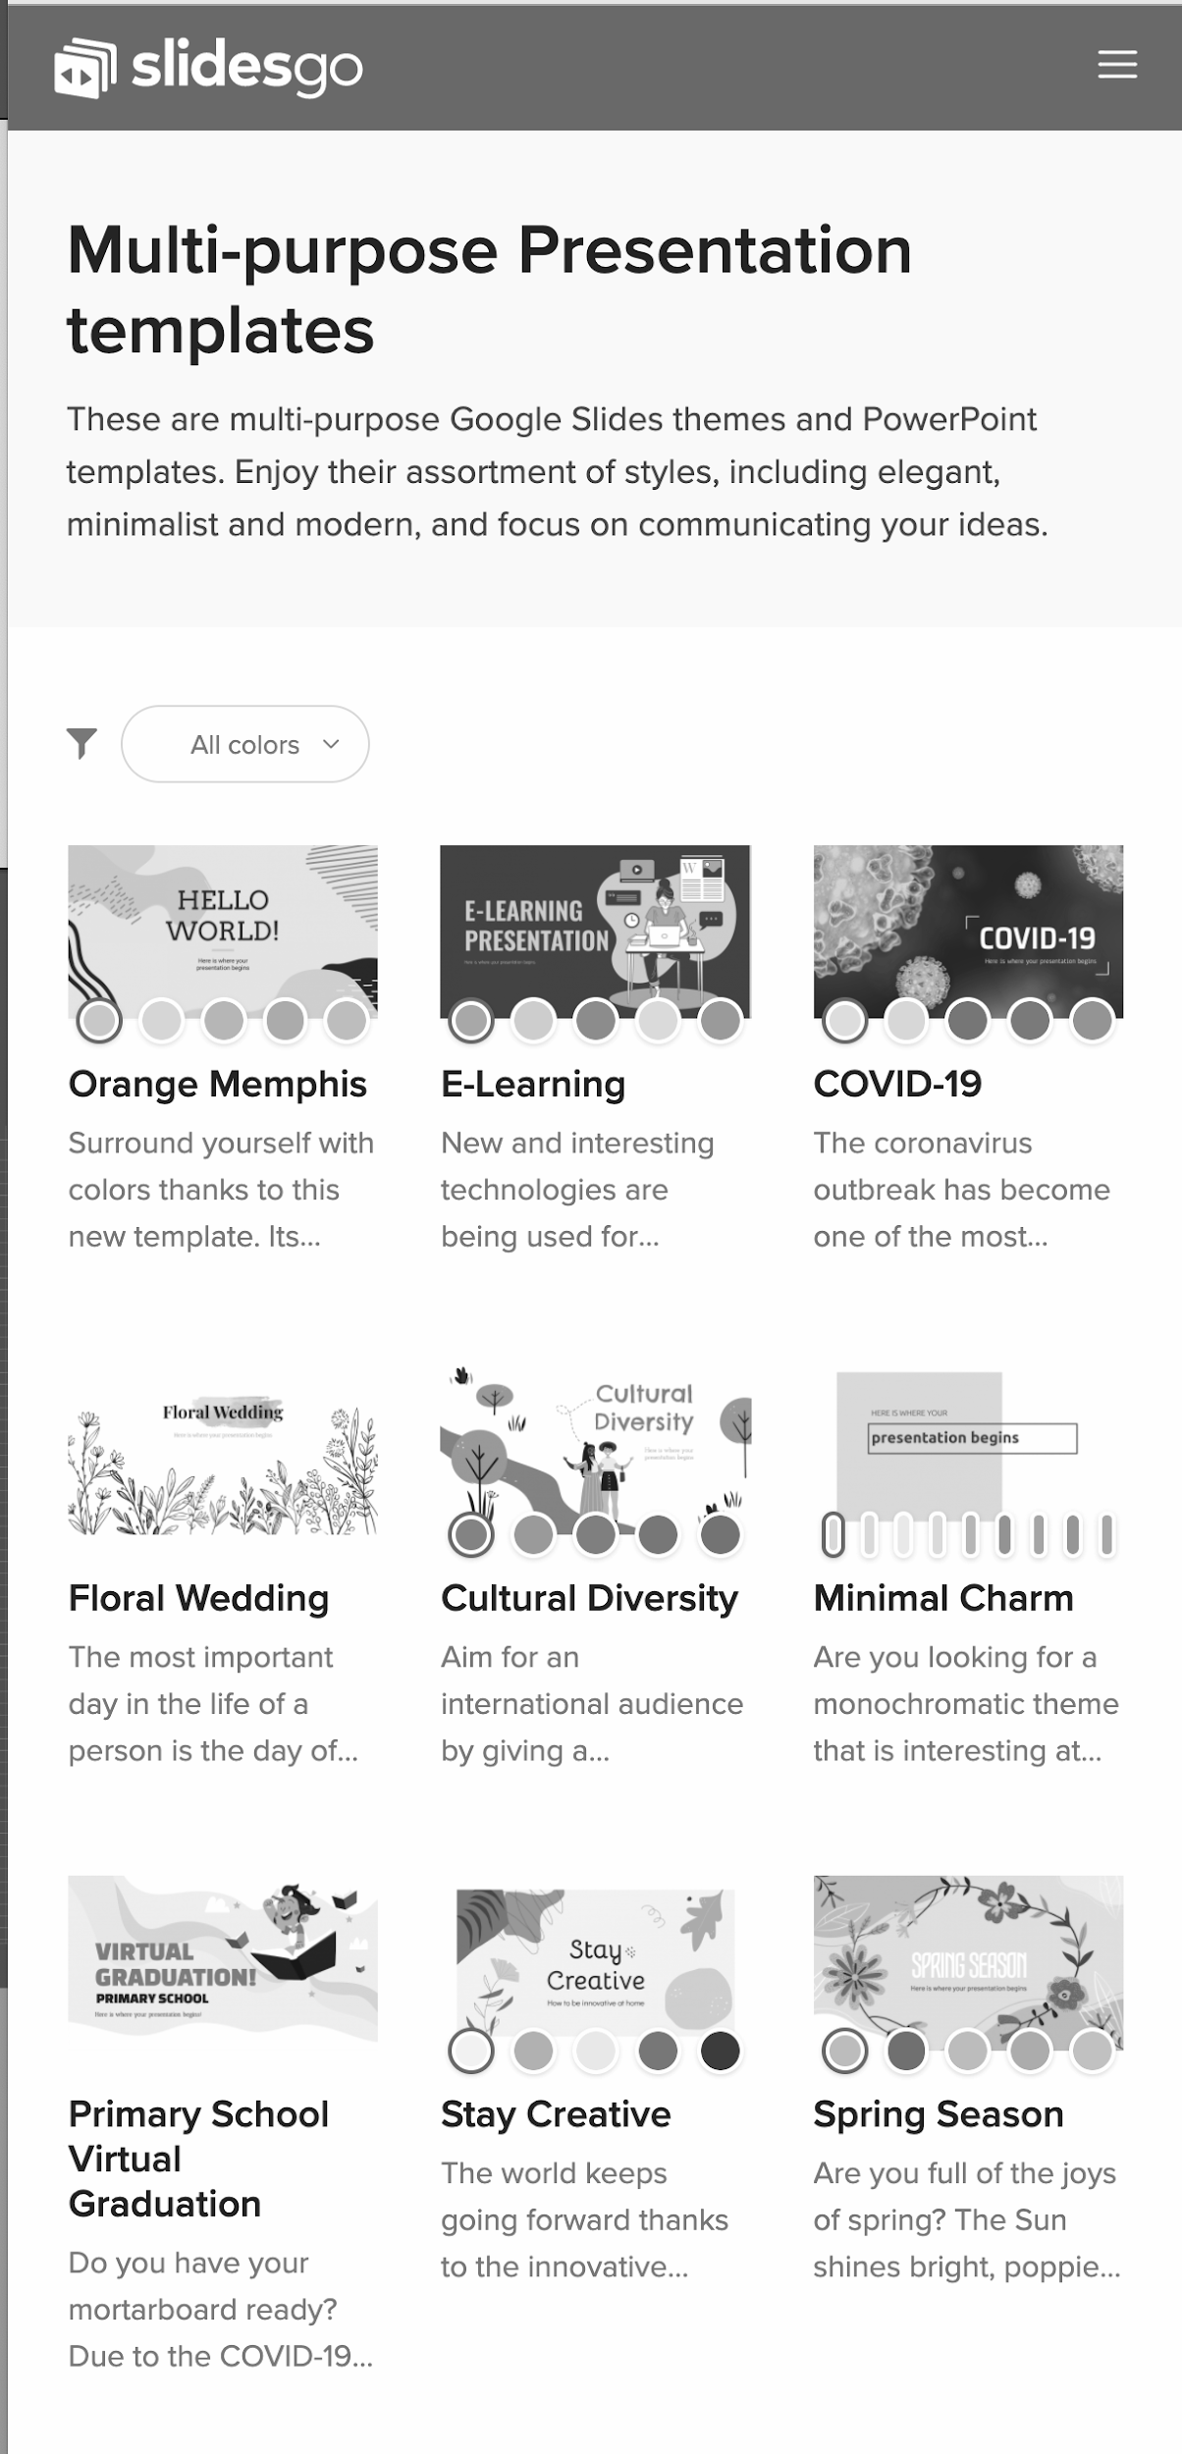
MOBILE WEB
You can replace the image on the screen with your own work. Just delete this one, add yours and center it properly

Slide 35
ALTERNATIVE RESOURCES
PHOTOS
Low Angle View Urban Buildings
Bottom View Crystal Building
Contemporary Black Building
Building With Clouds
Modern New Building
Skyscraper With Clouds
Low Angle Company Building
Businessman Talking Phone

Slide 36
RESOURCES
Did you like the resources on this template? Get them for free at our other websites.
PHOTOS
Confident Young Businessman
Buildings Sunny Day
Businessman
Contemporary Glass Skyscrapers
Employees Working With Graphics
Modern Tall Buildings
Building
Building With Reflection
Modern Glass Buildings
Glass High Rise Building
Skyscrapers Clear Blue Sky
Skyscraper With Cloudy Sky
Businesswoman Holding Folder
Group People Working
Modern Glass Building Bottom View
Medium Shot Smiley Man
Modern Skyscrapers
Cityscape With High Rise Buildings
VECTORS
Logo Template Collection
Flat Device Mockup Infographic

Slide 37
Instructions for use
In order to use this template, you must credit Slidesgo by keeping the Thanks slide.
You are allowed to:
- Modify this template.
- Use it for both personal and commercial projects.
You are not allowed to:
- Sublicense, sell or rent any of Slidesgo Content (or a modified version of Slidesgo Content).
- Distribute Slidesgo Content unless it has been expressly authorized by Slidesgo.
- Include Slidesgo Content in an online or offline database or file.
- Offer Slidesgo templates (or modified versions of Slidesgo templates) for download.
- Acquire the copyright of Slidesgo Content.
For more information about editing slides, please read our FAQs or visit Slidesgo School:
https://slidesgo.com/faqs and https://slidesgo.com/slidesgo-school

Slide 38
Fonts & colors used
This presentation has been made using the following fonts:
Barlow
(https://fonts.google.com/specimen/Barlow)
#0066ff
#589aff
#364951

Slide 39




Stories by Freepik
Create your Story with our illustrated concepts. Choose the style you like the most, edit its colors, pick the background and layers you want to show and bring them to life with the animator panel! It will boost your presentation. Check out How it Works.
Pana
Amico
Bro
Rafiki

Slide 40
Use our editable graphic resources...
You can easily resize these resources without losing quality. To change the color, just ungroup the resource and click on the object you want to change. Then, click on the paint bucket and select the color you want. Group the resource again when you’re done. You can also look for more infographics on Slidesgo.

Slide 43
JANUARY
FEBRUARY
MARCH
APRIL
MAY
JUNE
PHASE 1
Task 1
Task 2
PHASE 2
Task 1
Task 2
JANUARY
FEBRUARY
MARCH
APRIL
PHASE 1
Task 1
Task 2

Slide 46
...and our sets of editable icons
You can resize these icons without losing quality.
You can change the stroke and fill color; just select the icon and click on the paint bucket/pen.
In Google Slides, you can also use Flaticon’s extension, allowing you to customize and add even more icons.

Slide 47
Educational Icons
Medical Icons

Slide 48
Business Icons
Teamwork Icons

Slide 49
Help & Support Icons
Avatar Icons

Slide 50
Creative Process Icons
Performing Arts Icons

Slide 51
Nature Icons

Slide 52
SEO & Marketing Icons

Slide 53


